Slide 1

Session – 13 Scrum

Slide 2
Scrum Introduction
Scrum is a process framework used to manage product development and other knowledge work.
Scrum is empirical in that it provides a means for teams to establish a hypothesis of how they think something works, try it out, reflect on the experience, and make the appropriate adjustments. That is, when the framework is used properly.
Scrum is structured in a way that allows teams to incorporate practices from other frameworks where they make sense for the team’s context.
Scrum appears simple, yet has practices that deeply influence the work experience and that capture key adaptive and agile qualities.

Slide 3
What is Scrum?
Scrum:
Is an agile, lightweight process
Can manage and control software and product development
Uses iterative, incremental practices
Has a simple implementation
Increases productivity
Reduces time
Embraces the opposite of the waterfall approach…

Slide 4
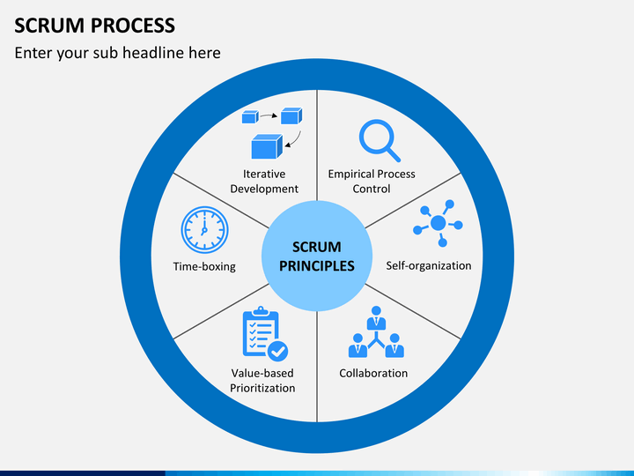
Scrum Principles

Slide 5
Scrum at a Glance
24 hours
Daily Scrum
Meeting
Backlog tasks
expanded
by team
30 days
Sprint Backlog
Potentially Shippable
Product Increment
Product Backlog
As prioritized by Product Owner
Source: Adapted from Agile Software Development with Scrum by Ken Schwaber and Mike Beedle.

Slide 6

Scrum Framework
Roles
Product owner
Scrum Master
ProjectTeam
Ceremonies
Sprint planning
Daily scrum meeting
Sprint review
Sprint retrospective
Artifacts/work products
Product backlog
Sprint backlog
Burndown charts

Slide 7







Scrum Roles
Product Owner
Possibly a Product Manager or Project Sponsor
Decides features, release date, prioritization, $$$
Scrum Master
Typically a Project Manager or Team Leader
Responsible for enacting Scrum values and practices
Remove impediments / politics, keeps everyone productive
Project Team
5-10 members; Teams are self-organizing
Cross-functional: QA, Programmers, UI Designers, etc.
Membership should change only between sprints

Slide 8
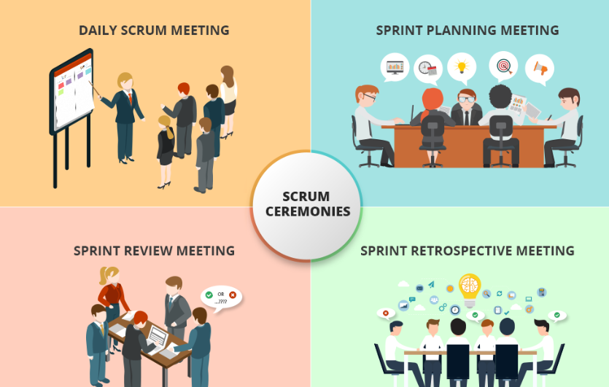
Scrum Ceremonies

Slide 9



Sprint Planning Mtg.
Business conditions
Sprint planning meeting
Sprint prioritization
Current product
Sprint
goal
Analyze/evaluate product backlog
Select sprint goal
Technology
Sprint planning
Team capacity
Decide how to achieve sprint goal (design)
Create sprint backlog (tasks) from product backlog items (user stories / features)
Estimate sprint backlog in hours
Sprint
backlog
Product backlog

Slide 10
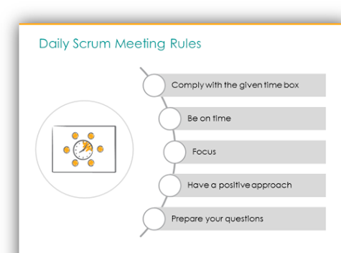
Daily Scrum Meeting
Parameters
Daily, 15 minutes, Stand-up
Anyone late pays a $1 fee
Not for problem solving
Whole world is invited
Only team members, Scrum Master, Product owner, can talk
Helps avoid other unnecessary meetings
Three questions answered by each team member:
What did you do yesterday?
What will you do today?
What obstacles are in your way?

Slide 11
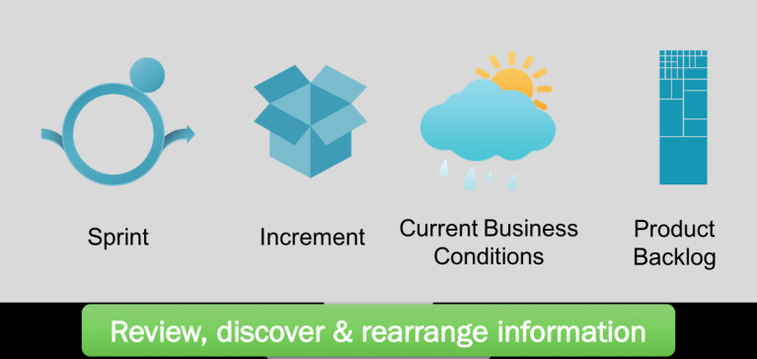
Sprint Review
Sprint Review is held at the end of the Sprint
to inspect the Increment and adapt the
Product Backlog if needed.
Attendees: Scrum Team and key stakeholders;
Product Owner: explains what Product Backlog items have been “Done” and what has not been “Done”; he projects likely target and delivery dates based on progress to date (if needed);
Development Team: what went well, what problems it ran into, and how those problems were solved;
The Development Team demonstrates the work that it has “Done” and answers questions about the Increment;
The Product Owner or Team or entire group collaborates on what to do next, so that the Sprint Review provides valuable input to subsequent Sprint Planning

Slide 12
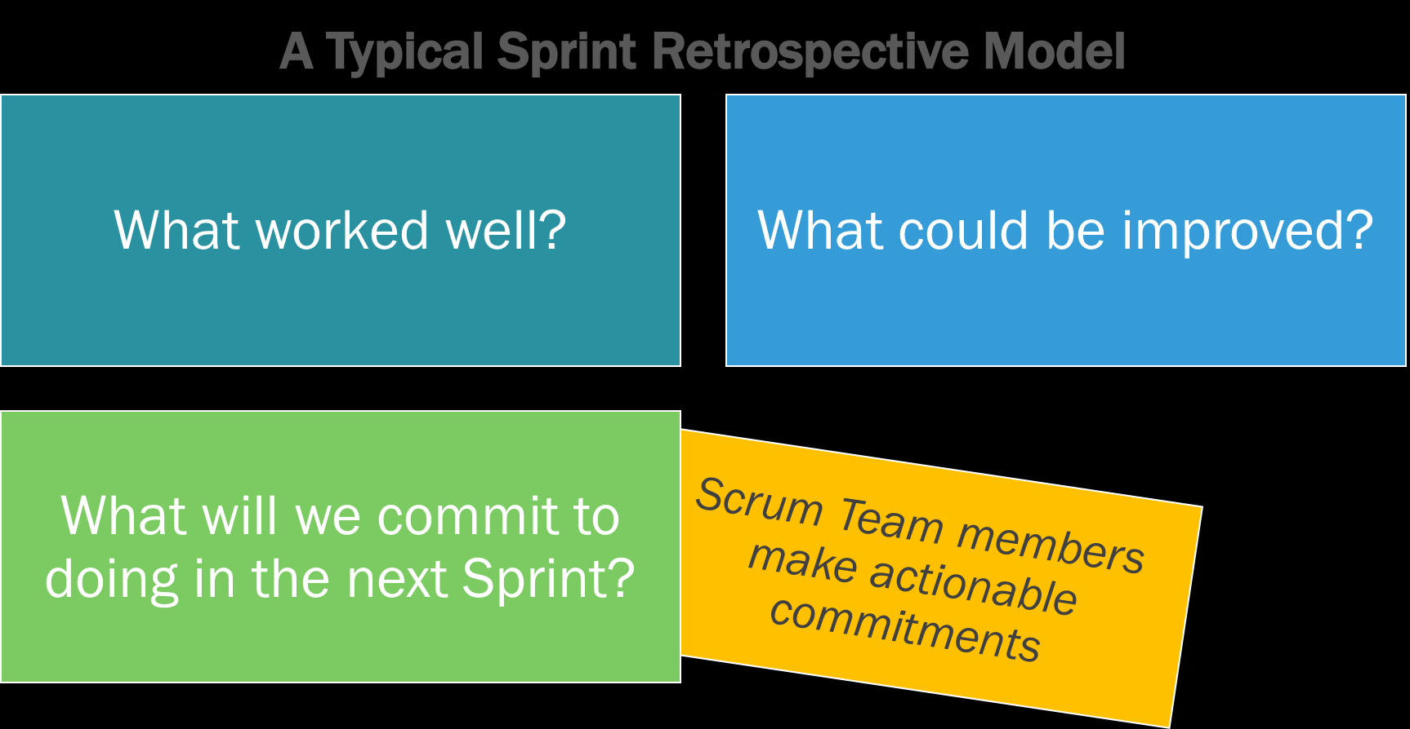
Sprint Retrospective

Slide 13
Scrum's Artifacts/Work products
Scrum has remarkably few artifacts
Product Backlog
Sprint Backlog
Burndown Charts
Can be managed using just an Excel spreadsheet
More advanced / complicated tools exist:
Expensive
Web-based – no good for Scrum Master/project manager who travels
Still under development

Slide 14

Product Backlog
The requirements
A list of all desired work on project
Ideally expressed as a list of user stories along with "story points", such that each item has value to users or customers of the product
Prioritized by the product owner
Reprioritized at start of each sprint
This is the product backlog

Slide 15
User Stories
Instead of Use Cases, Agile project owners do "user stories"
Who (user role) – Is this a customer, employee, admin, etc.?
What (goal) – What functionality must be achieved/developed ?
Why (reason) – Why does user want to accomplish this goal?
As a [user role], I want to [goal], so I can [reason].
Example:
"As a user, I want to log in, so I can access subscriber content."
story points:is a metric used to estimate the difficulty of implementing a given user story. A number that tells the team about the difficulty level of the story.
Rating of effort needed to implement this story
common scales: 1-10, shirt sizes (XS, S, M, L, XL), etc.

Slide 16
Sprint Backlog
Individuals sign up for work of their own choosing
Work is never assigned
Estimated work remaining is updated daily
Any team member can add, delete change sprint backlog
Work for the sprint emerges
If work is unclear, define a sprint backlog item with a larger amount of time and break it down later
Update work remaining as more becomes known

Slide 17
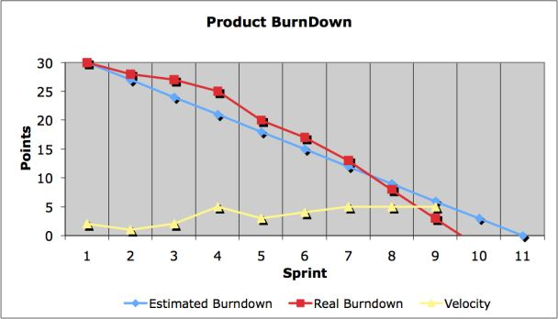
Burndown Chart
It is a visual measurement tool that shows the completed work per day against the projected rate of completion for the current project release. Its purpose is to enable that the project is on the track to deliver the expected solution within the desired schedule.

Slide 18
Questions
Define SCRUM.
Explain Method Overview of scrum.
Sketch and explain Lifecycle of scrum.
Explain Workproducts, Roles, and Practices.

Slide 19
End of Session 13

